Slide 1


Slide 2
PROBLEM SOLVING & PROGRAMMING II
Week 2
FUNCTION BASICS

Slide 3
OBJECTIVES
You should be able to:
design & write your own functions
properly define and utilize global & local variables
pass by value or pass by reference

Slide 4
user defined functions Class notes
Week 3
FUNCTION BASICS

Slide 5
Ex 1: Function to add 2 numbers
Function declaration:
A function declaration tells the compiler the
return type, function's name, parameters
double add(int num1, double num2);
//PRE: function will take 2 numbers
//POST: function will return the sum
int main (){
add (6, 7);
}
Function definition:
A function definition is the actual body of the function
double add(int num1, double num2){
return num1 + num2;
}

Slide 6

EX 1: ADD FUNCTION
// Show how to program using functions
#include <iostream>
using namespace std;
// function declaration
int add(int x, int y);
//PRE: function will take 2 numbers
//POST: function will return the sum
void main() {
int z, a, b;
cout << "Enter two numbers to add:\n";
cin >> a >> b;
z = add(a, b);
cout << "The result is " << z;
}
// function definition
int add(int x, int y) {
int sum;
sum = x + y;
return sum;
}
1- Preconditions: states what is assumed to be true before the function is called.
2- Postcondition: describes the effect when the function is called( what is the function computing and will be returned)
https://bit.ly/CS201Wk3a1
Variables declared inside the function definition are said to be local to that function.
If x,y or sum were used elsewhere, they would not interfere with the values in the function
Notes:
Starting code has mult() function

Slide 7

EX 2: LOCAL VARIABLE
int mult(int x, int y) {
int total;
x = 7;
y = 10;
total = x * y;
return total;
}
#include<iostream>
using namespace std;
void main()
{
int a = 3, b = 5, prod = 0;
prod = mult(a,b);
cout << a << " * " << b << " = " << z << endl;
}
This is a case of pass by value
//x & y are ‘local’ to mult
//new space is created when ‘mult’ function is executed
//but a & b in the main function are not updated

Slide 8

EX 2: LOCAL VARIABLE
double mult(double &x, double &y) {
double total;
x = 7;
y = 10;
total = x * y;
return total;
}
#include<iostream>
using namespace std;
void main()
{
double a = 3, b = 5, prod = 0;
prod = mult(a,b);
cout << a << " * " << b << " = " << z << endl;
}
This is a case of pass by reference
//x & y are pointing to the SAME SPACE as a & b
// a & b in the main function ARE updated

Slide 9
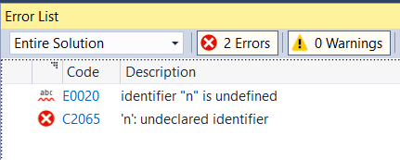
EX 2: LOCAL VARIABLE
#include<iostream>
using namespace std;
void main()
{
int i = 10;
if (i < 20)
int n = i;
cout << n;
}
//n is defined in the if statement & is local to that ‘block’

Slide 10
EX 4: YOUR TURN
Create 2 Functions
areaCircle
// precondition: accepts a positive double value representing radius
// postcondition: returns area of circle (double) = pi*r²
volumeSphere
// precondition: accepts a positive double value representing radius
// postcondition: returns volume of the sphere (double) = (4/3)pi*r³

Slide 11
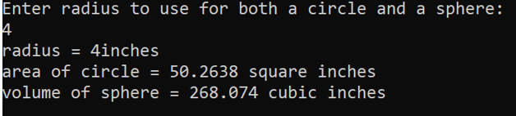
#include<iostream>
#include<cmath>
using namespace std;
const double PI = 3.14149;
double area(double radius);
// pre: accepts a positive value representing radius
// post: returns area of circle
double volume(double radius);
// pre: accepts a positive value representing radius
// post: returns the volume of sphere
int main()
{
double circleRadius, areaCircle, volumeSphere;
cout << "Enter radius to use for both a circle and a sphere:\n";
cin >> circleRadius;
areaCircle = area(circleRadius);
volumeSphere = volume(circleRadius);
cout << "radius = " << circleRadius << "inches \n" << "area of circle = " << areaCircle << " square inches\n" << "volume of sphere = " << volumeSphere << " cubic inches \n";
return 0;
}
EX 4: YOUR TURN
double area (double raduis)
{
return (PI *pow(raduis,2));
}
double volume(double raduis)
{
return ((4.0/3.0)* PI *pow(raduis,3));
}

Slide 12
EXAMPLE 5
EX 5: THE SWAP
Swapping 2 numbers is a typical thing when sorting…
It is used SO often that we have a function to do so:
void swap(int x, int y) {
int temp = x;
x = y;
y = temp;
}
swap(a, b);
PASS BY VALUE:
x & y are in new memory locations with a copied value of a & b
void swap(int &x, int &y) {
int temp = x;
x = y;
y = temp;
}
PASS BY REFERENCE:
to allow x & y to change values, you must include '&' before each
so a new memory location is not created
Notes:
//NOTE: a, b, and temp are local variables
// PASS BY VALUE: a & b are in new memory locations with a copied value of x & y
// PASS BY REFERENCE: to allow a & b to change values, you must include '&' before each so a new memory location is not created

Slide 13
EXAMPLE 6
EX 6: YOUR TURN
Suppose you can buy a chocolate bar from the vending machine for $1 each. Inside every chocolate bar is a coupon. You can redeem 7 coupons for one chocolate bar from the machine. You would like to know how many chocolate bars you can eat, including those redeemed via coupon, if you have n dollars.
For example, if you have 20 dollars then you can initially buy 20 chocolate bars, this gives you 20 coupons. You can redeem 14 coupons for two additional chocolate bars. These two additional chocolate bars give you two more coupons, so you now have a total of 8 coupons. This gives you enough to redeem for one final chocolate bar . As a result you now have 23 chocolate bars and one leftover coupon.
Write a program that inputs the number of dollars and outputs how many chocolate bars you can collect after spending all your money and redeeming as many coupons as possible. Also output the number of leftover coupons.(Hint: use loop)
Notes:
while (coupon >= 7)
{
bars += coupon / 7;
coupon = coupon / 7 + coupon % 7;
}

Slide 14
User defined functionS more detail
Week 2
FUNCTION BASICS

Slide 15
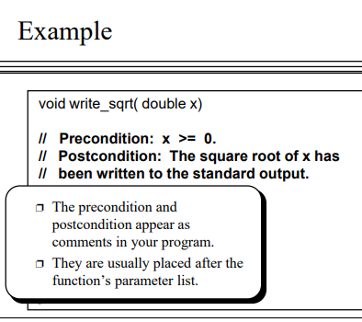
PRECONDITIONS include:
Arguments expected:
Number of arguments
Type
Value
Function purpose
WHAT the function does, not HOW it is done
Value returned
Changes made any to pass-by-reference values
POSTCONDITIONS include:
Notes:
NOTE: using const as the argument definition prevents changes to that value in the function – a good programming technique for clarity

Slide 16
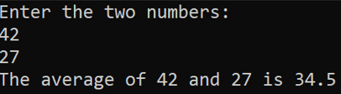
EX 3: AVERAGE FUNCTION
#include<iostream>
using namespace std;
double avg(int x, int y);
//PRE: The function will take two positive integer numbers x and y
//POST: The function will return the average of two numbers
void main()
{
int a, b;
cout << "Enter the two numbers:\n";
cin >> a >> b;
cout << "The average of " << a << " and " << b << " is " << avg(a,b) << endl;
}
double avg(int x, int y)
{
double result;
result = (x + y) / 2.0;
return result;
}

Slide 17

Without the Declaration
EX 3 : AVERAGE FUNCTION
// Show how to program using functions
#include <iostream>
using namespace std;
int main()
{
int z, a, b;
cout << "Enter two numbers to add:\n";
cin >> a >> b;
z = avg(a, b);
cout << "The result is " << z;
return 0;
}
// function definition
double avg(int x, int y)
{
double result;
result = (x + y) / 2.0;
return result;
}
ERROR

Slide 18

Without the Declaration
// Show how to program using functions
#include <iostream>
using namespace std;
// function definition
int add(int a, int b) {
//PRE: The function will take two positive integer numbers x and y
//POST: The function will return the average of two numbers
int sum;
sum = a + b;
return sum;
}
int main()
{
int z, a, b;
cout << "Enter two numbers to add:\n";
cin >> a >> b;
z = add(a, b);
cout << "The result is " << z;
return 0;
}
EX 3: AVERAGE FUNCTION
FUNCTION DECLARATION & DEFINITION COMBINED

Slide 19
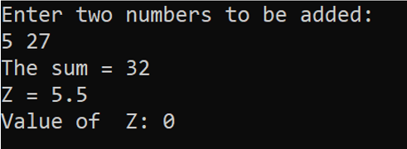
LOCAL AND GLOBAL VARIABLES
#include<iostream>
using namespace std;
// add function return the sum of two numbers,
int add(int x, int y);
//value function return the value of x
double value(double x);
void main() {
int x, y;
double z = 0;
cout << "Enter two numbers to be added:\n";
cin >> x >> y; //5, 27
cout << "The sum = " << add(x, y) << endl;
cout << "Z = " << value(z) << endl;
cout << "Value of Z: " << z << endl;
}
int add(int x, int y){
return (x + y);
}
double value(double x){
x = 5.5;
return x;
}
z
0
x
0
x
5.5

Slide 20
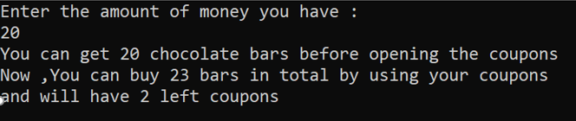
#include<iostream>
using namespace std;
void main()
{
int dollars;
int bars;
int coupon;
cout << "Enter the amount of money you have :\n";
cin >> dollars;
bars = dollars;
cout << "You can get " << bars << " chocolate bars before opening the coupons\n";
coupon = bars;
//while loop is used to calculate number of bars after redeeming the coupons and number of coupons leftover
while (coupon >= 7)
{
bars += coupon / 7;
coupon = coupon / 7 + coupon % 7;
}
cout << "Now ,You can buy " << bars << " bars in total by using your coupons\n";
cout << "and will have " << coupon << " left coupons\n";
}
EXAMPLE 5 SOLUTION
No functions

Slide 21
#include<iostream>
using namespace std;
int get_bars(int dollars);
// Pre : None
// Post : update parameter dollars
void calculate_results(int bars, int coupons);
// Pre: global bars has been set
// Post : bars will be set to the total amount
void output_results(int bars, int coupons);
// Pre : bars and coupons have been updated
// Post : output the results of the program
void main()
{
dollars = get_bars();
bars = dollars;
coupons = bars;
calculate_results();
output_results(bars, coupons);
}
EXAMPLE 5 SOLUTION
Using functions
void calculate_results() {
//while loop is used to calculate number of bars after redeeming the coupons and number of coupons leftover
while (coupons >= 7)
{
bars += coupons / 7;
coupons = coupons / 7 + coupons % 7;
}
}
void output_results(int final_bars, int final_coupons) {
cout << "Now ,You can buy " << final_bars << " bars in total by using your coupons\n";
cout << "and will have " << final_coupons << " left coupons\n";
}
int get_bars() {
int user_dollars;
cout << "Enter the amount of money you have :\n";
cin >> user_dollars;
cout << "You can get " << user_dollars << " chocolate bars before opening the coupons\n";
return user_dollars;
}
Notes:
bars += coupons / 7;
coupons = coupons / 7 + coupons % 7;

Slide 22
PREDEFINED VOID FUNCTIONS
#include<iostream>
using namespace std;
void main()
{
cout << "This program is used to show how exit(1) is used\n";
exit(1);
cout << "Nothing will be executed after using exit(1)\n";
}

